Slide 1
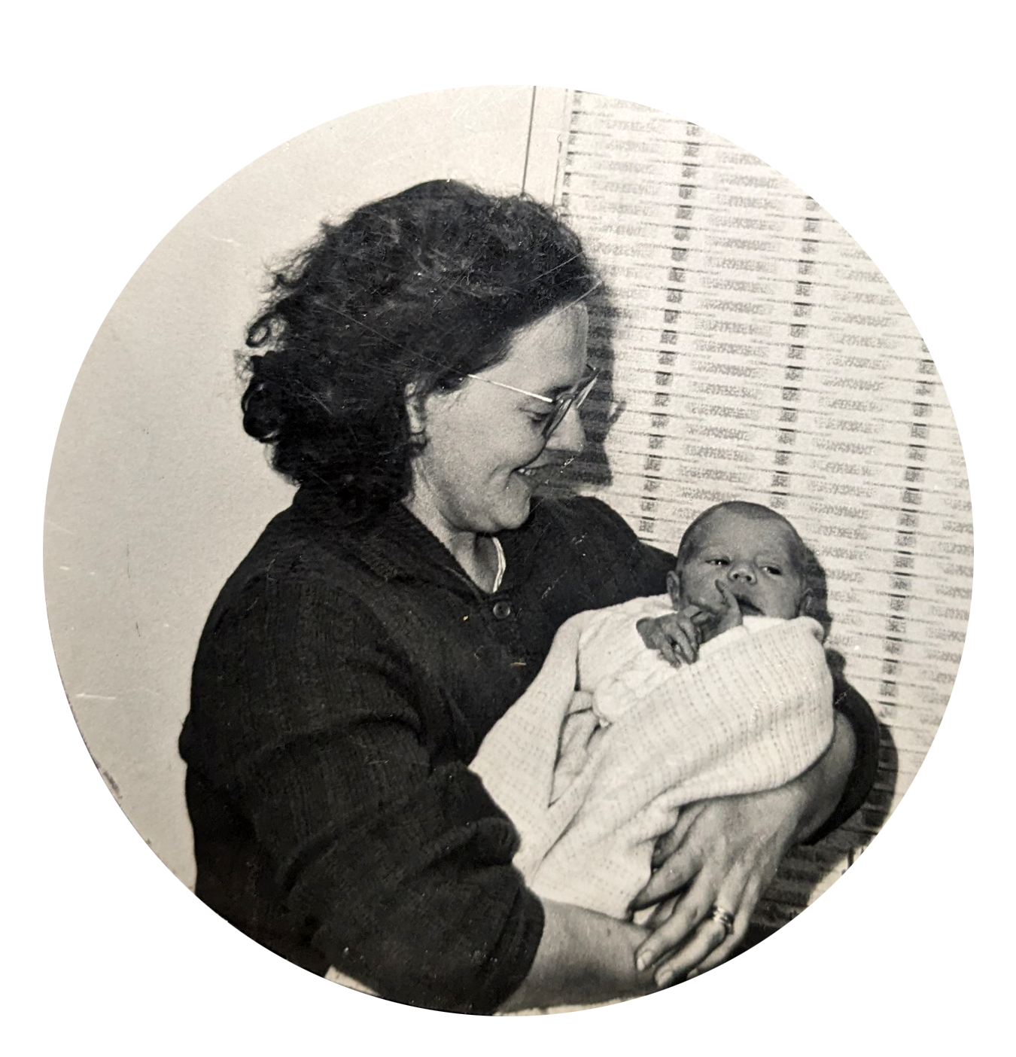
Martin Reid

Slide 2
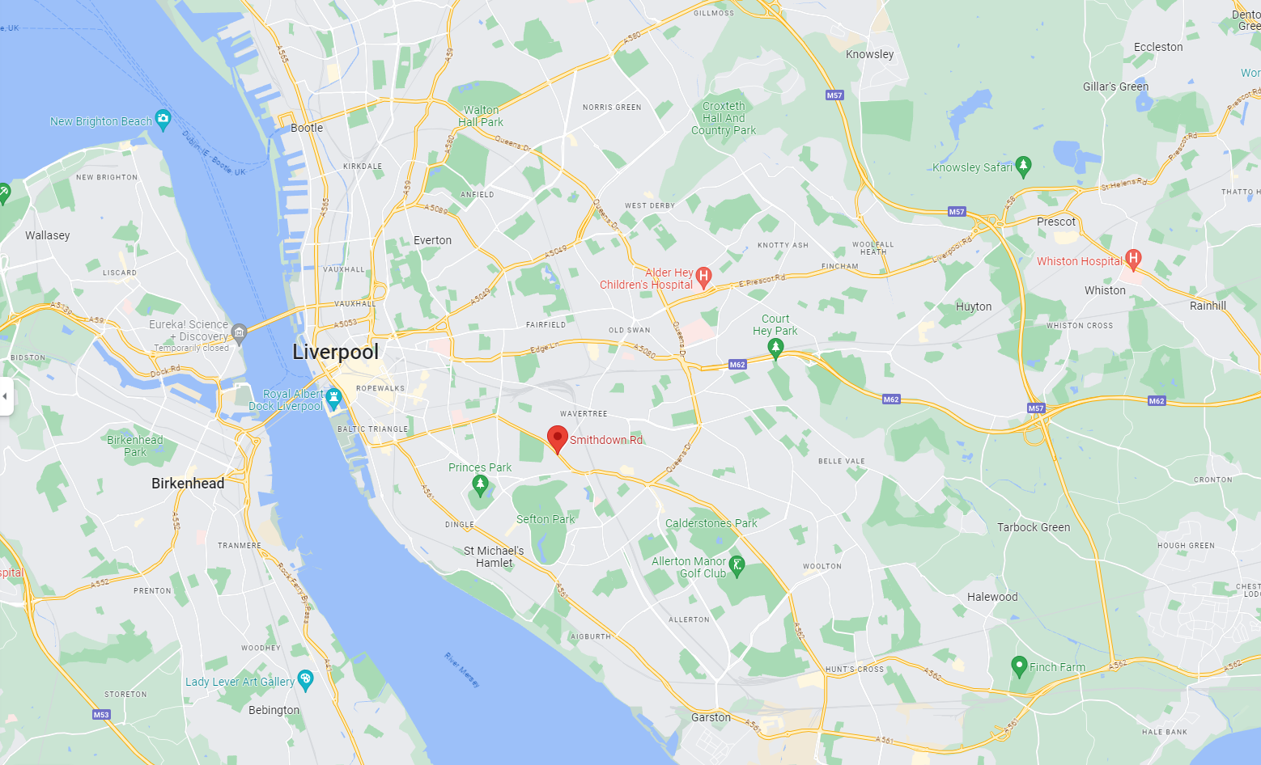
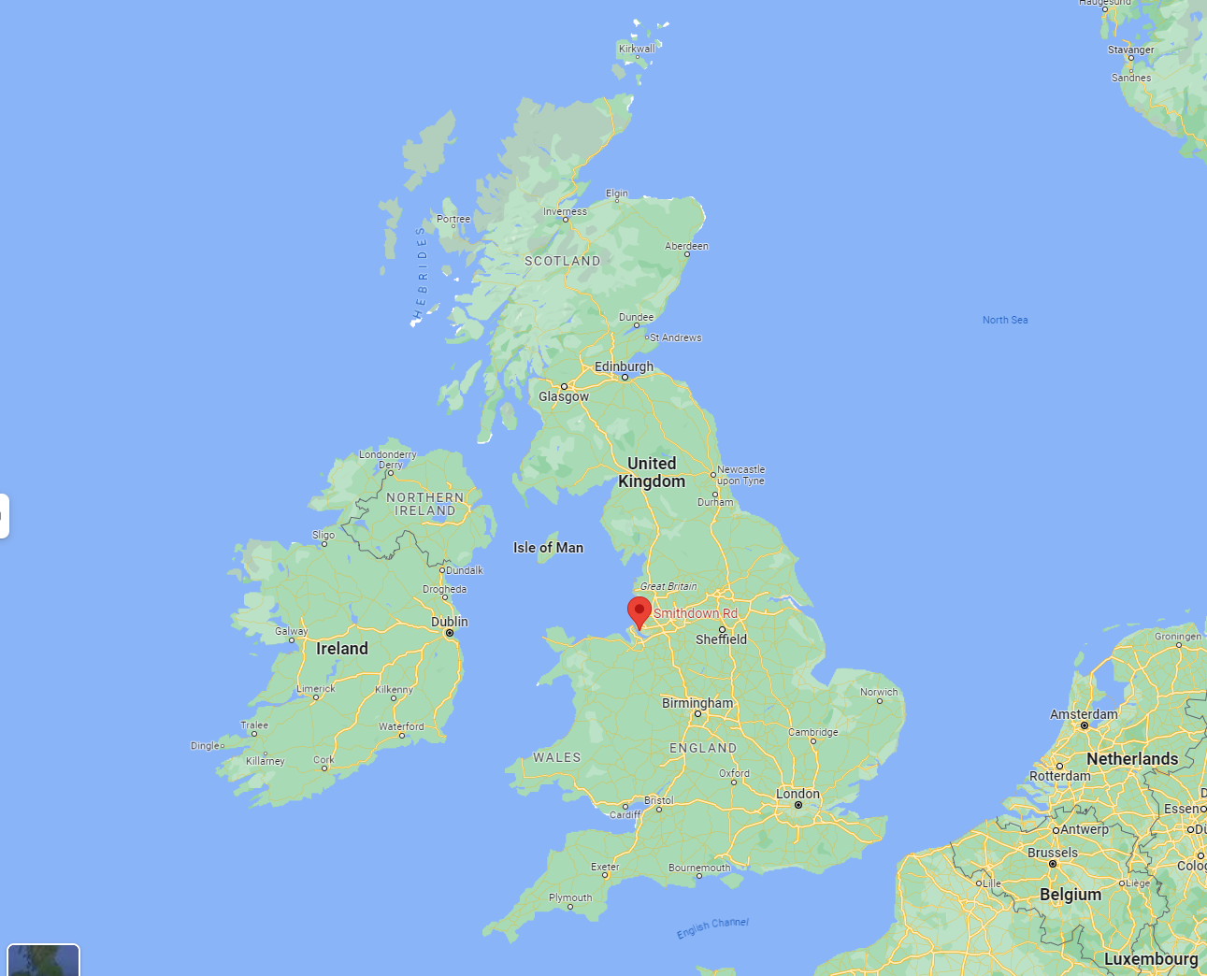

Slide 3
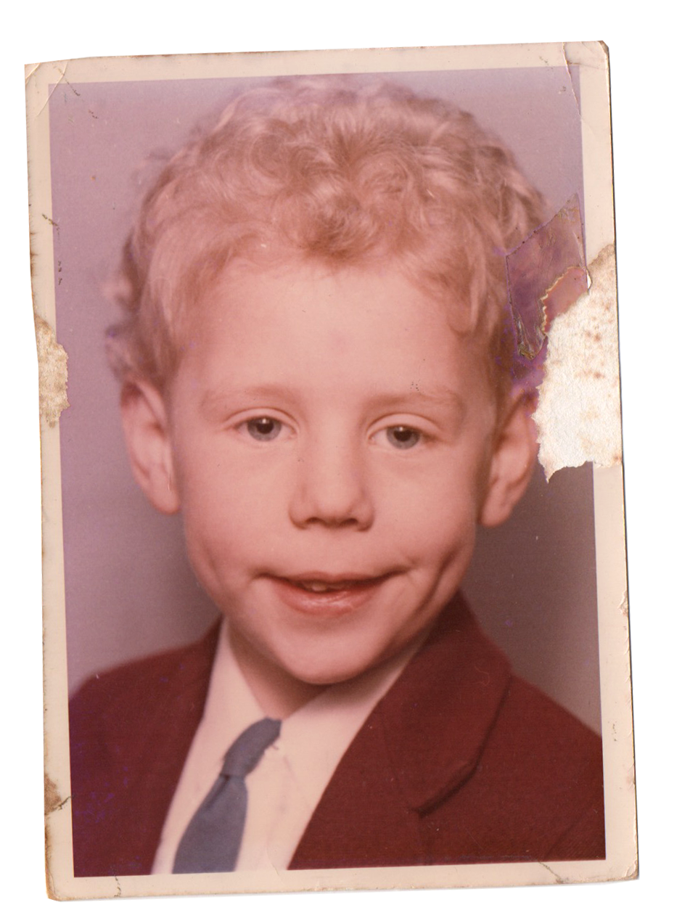
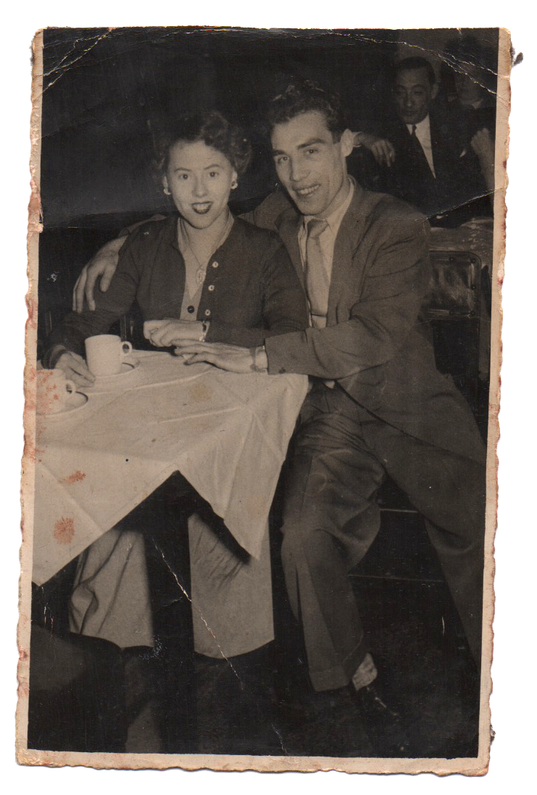

Slide 4
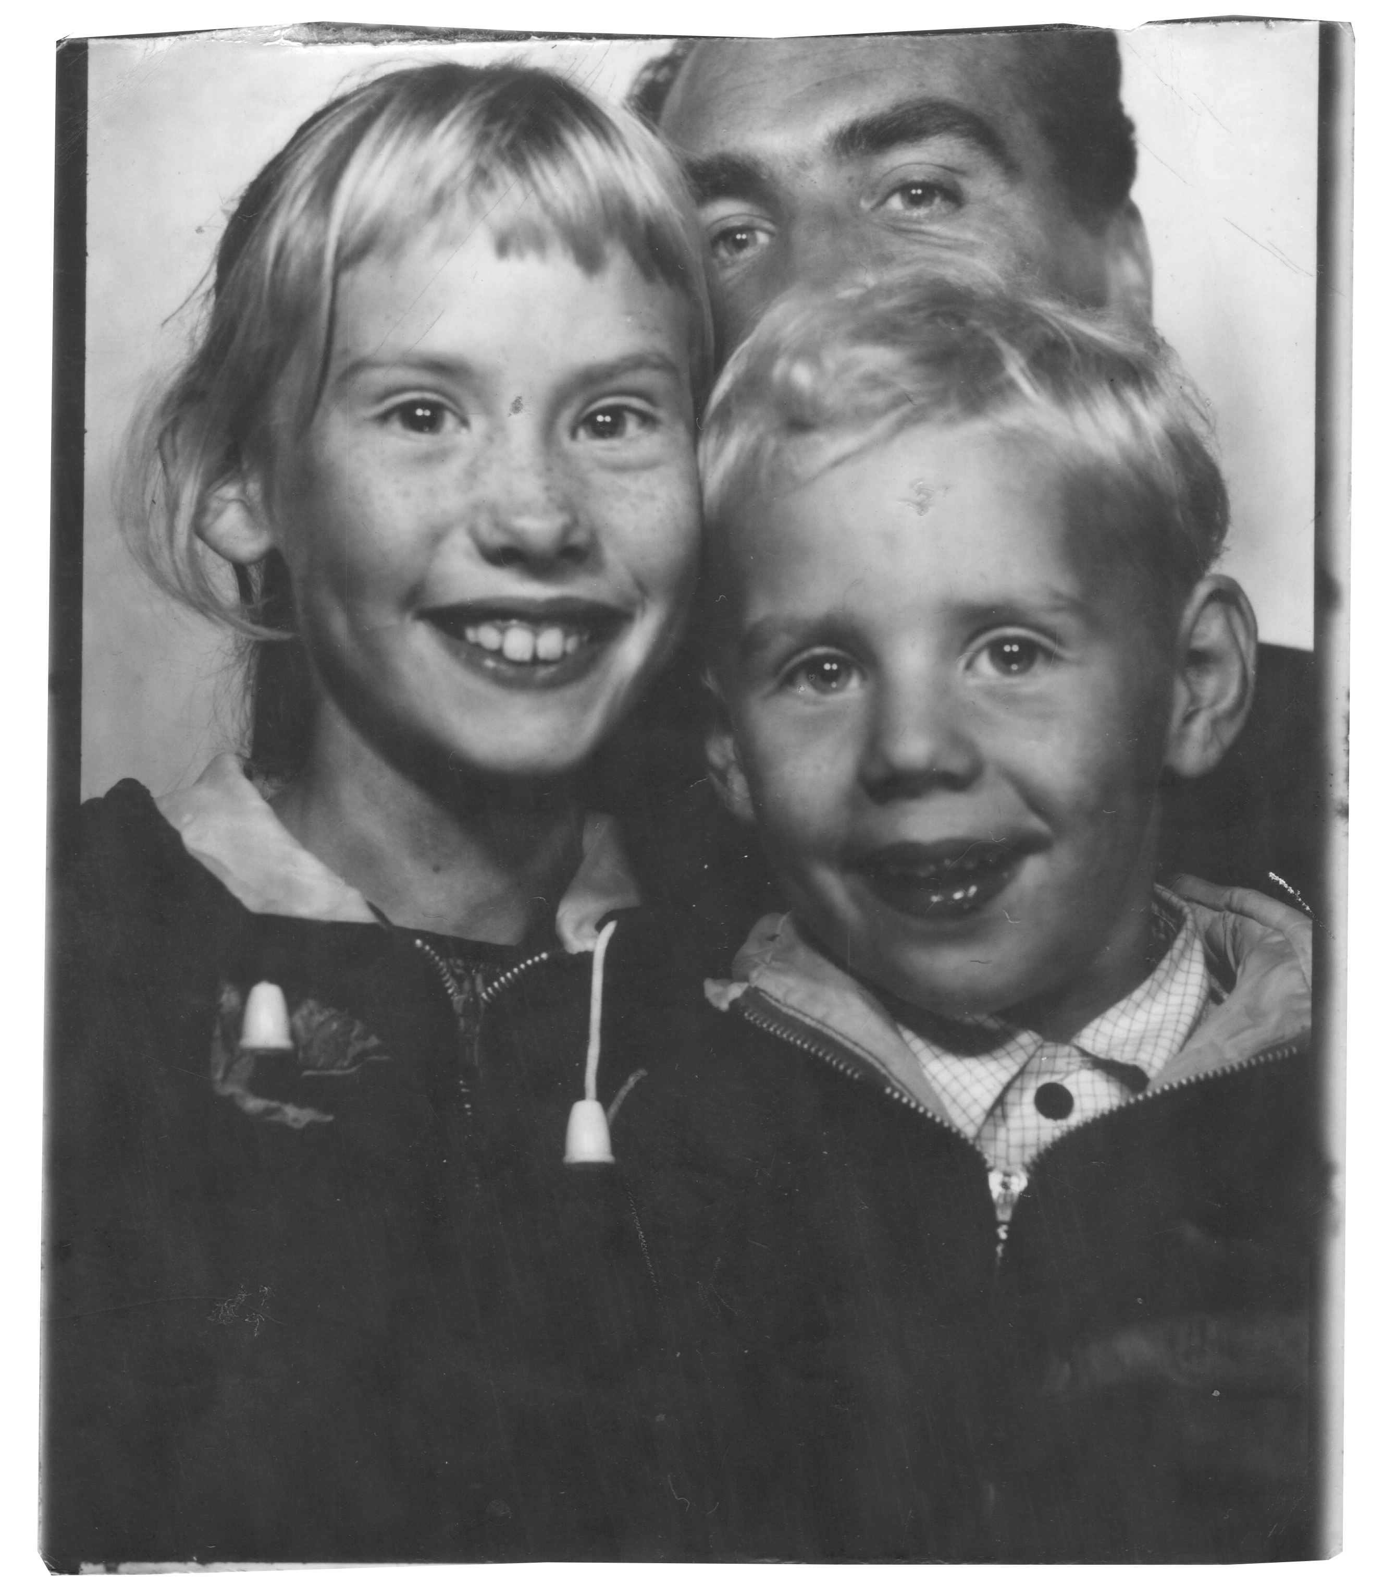
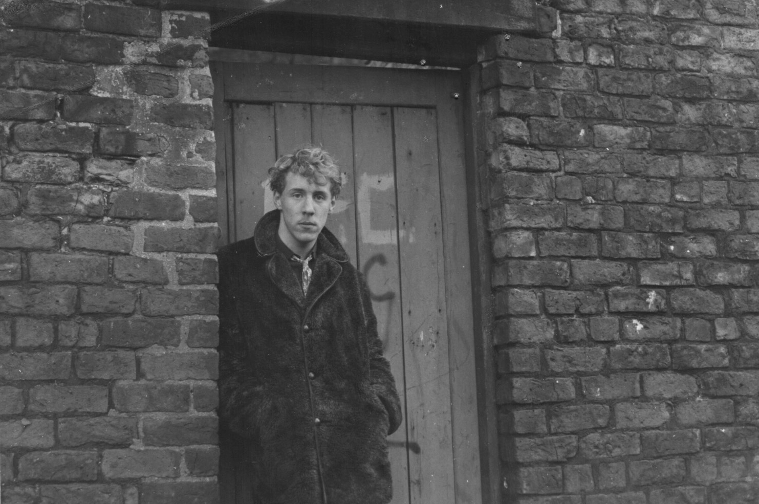

Slide 5
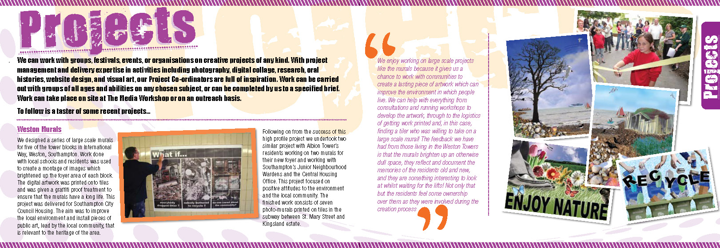
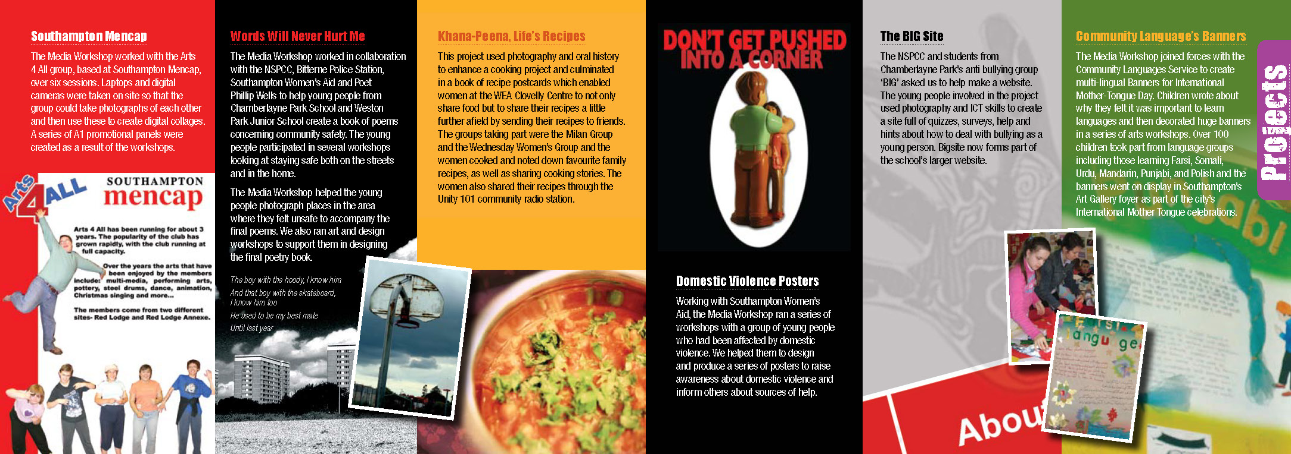
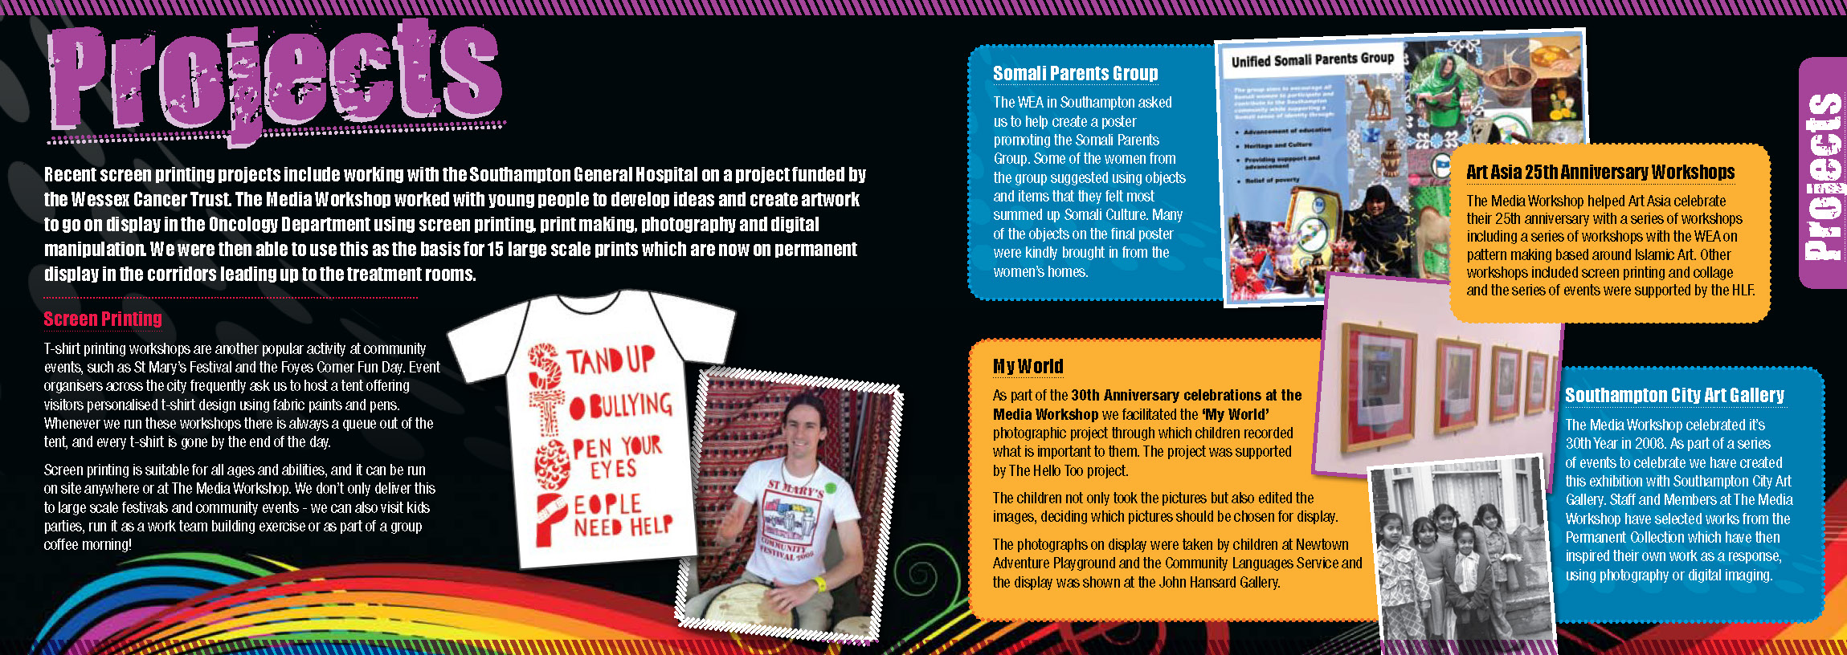
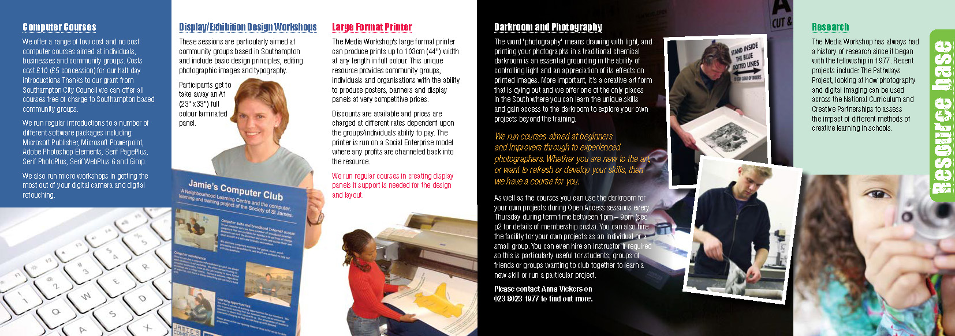

Slide 6

TRANSFORMATION

Slide 7

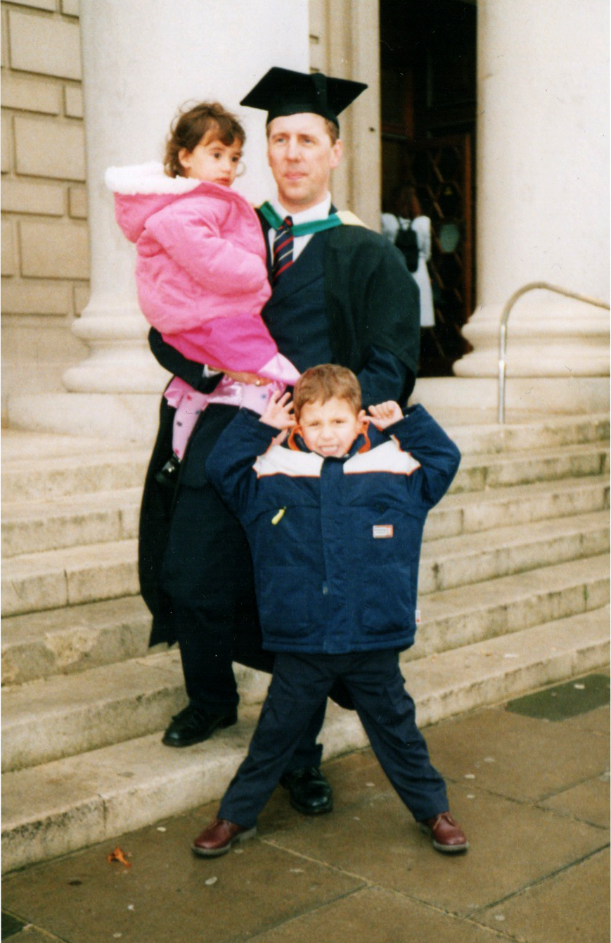

Slide 8
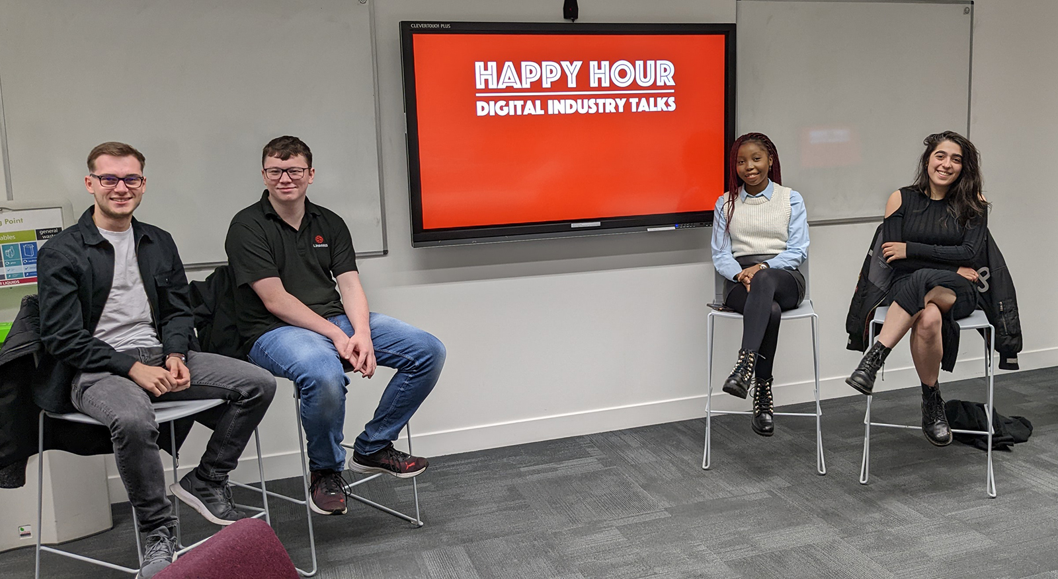
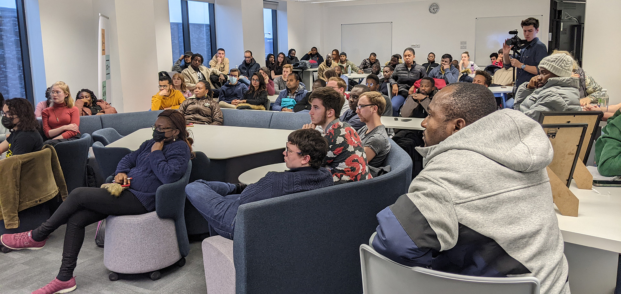

Slide 9
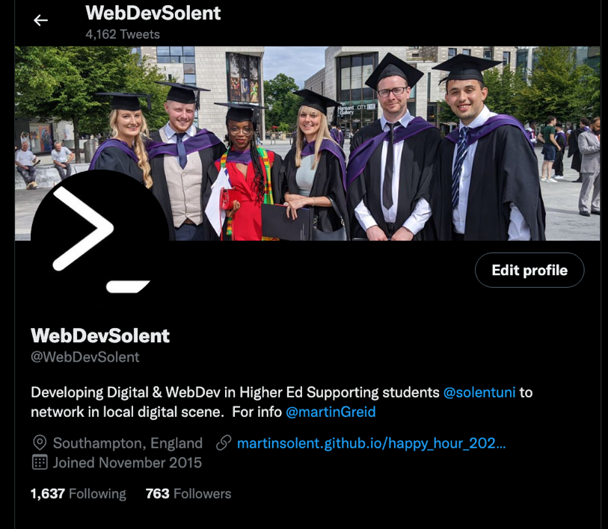
@WebDevSolent
Notes:
About Me
Working class backgrounds in Liverpool left school at 14
My sister got on with academic work effortlessly
struggled at school didn't do well and hated it
Went to college 18 to do design foundation old school graphic design and photography
Got it into photography with ideas as being a documentary photographer I'm left to go to another college to do photography full-time - didn't like the course wasn't there's a sucky student
Try to get into university to do photography about four times - but didn't get in - this is hindsight was no bad thing as I walls nought ready academically or emotionally
Got interested in community arts through camera works magazine
Went on to work and community ought for 28 years I'm Working on various projects with community groups
While I was still working in community arts a friend of mine hard apply to go on a Masters course at Southampton Institute now Solent university - wasn't sure due to mean not getting on well in education before
But everything clicked into place I really enjoyed the course gain confidence learnt a lot - the theory covered post-modernism and globalisation which related to almost of the topics in my community all job - and through doing this course I truly believe in the transformation possible in higher education.

Slide 10
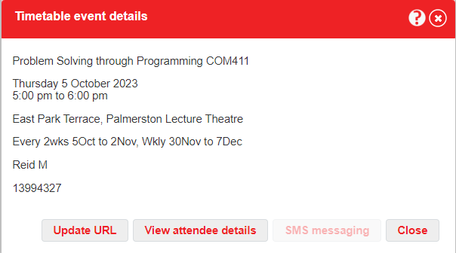
Happy Hour Session are on you timetable (COM411) every other week starting 5th October
https://martinsolent.github.io/happy_hour_2022/

Slide 11
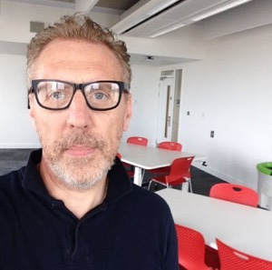
Martin Reid
Apprenticeship Programme Manager Course Leader for: Computing Foundation Level 4 Data Analyst Apprenticeship HNC (HTQ 2024) Data Analyst BSc (Hons) Digital Design and Web Development (L6) BSc (Hons) Digital and Technology Solutions (Apprenticeships), MSc Digital Design Office: JM506
martin.reid@solent.ac.uk
Computing | Science & Engineering
Solent University - Southampton

